Slide 1


CNP27: SARS-CoV-2-NSP14 target-384 compounds (Nick Heaton’s library) HTS
Hadia Almahli
15th Nov 2024
Notes:
For cytotoxicity, higher is better (i.e. less toxic). They are normalized to DMSO, so 100% means the same (lack of) toxicity as DMSO. Opposite with virus; it is normalized to DMSO so lower is better (showing that virus is more inhibited than DMSO).
Two things to note: Those are single cycle infection assays, so they probably aren’t good readouts for inhibition of NSP14. We’re doing better assays now. And we had a few hit compounds that we missed earlier and have now characterized. Most are similar to the “141-J15 and 159-P9” related compounds, I’ll show that data tomorrow.

Slide 2

CNP27: SARS-CoV-2-NSP14 target-384 compounds (Nick Heaton library) HTS
RA-0138504-02- Right hand side expansion
Purification issue:
UV invisible impurities- got the product after multiple purifications
1- J. AM. CHEM. SOC. 2007,129, 3078-3079
Notes:
Use cesium carbonate (2 eq) and 0.95 eq of alkyle aldehyde
Check Bordwell PKa table
I should add 2 eq base and one eq alkyle
PKa NH amide is 17/ PKa NH purrole is 15-> amide is more basic than pyrrole
The rule says: the latest deprotonated is the first alkylated that means the more basic group is the 1st alkylated
The archetypal Beckmann rearrangement^{[4]} is the conversion of cyclohexanone to caprolactam via the oxime
Cyclopentapyrrole and Cyclohexapyrrole analogues.
Pyrrole piperidinone

Slide 3

CNP27: SARS-CoV-2-NSP14 target-384 compounds (Nick Heaton library) HTS
Tetrahedron Letters, Volume 55, Issue 41, 2014,Pages 5591-5594,
https://doi.org/10.1016/j.tetlet.2014.08.060.
The Journal of Organic Chemistry 2008 73 (7), 2792-2802
DOI: 10.1021/jo8001003
Notes:
Use cesium carbonate (2 eq) and 0.95 eq of alkyle aldehyde
Check Bordwell PKa table
I should add 2 eq base and one eq alkyle
PKa NH amide is 17/ PKa NH purrole is 15-> amide is more basic than pyrrole
The rule says: the latest deprotonated is the first alkylated that means the more basic group is the 1st alkylated
The archetypal Beckmann rearrangement^{[4]} is the conversion of cyclohexanone to caprolactam via the oxime
Cyclopentapyrrole and Cyclohexapyrrole analogues.
Pyrrole piperidinone

Slide 4
CNP27: SARS-CoV-2-NSP14 target-384 compounds (Nick Heaton library) HTS
RA-0138504-02- Lift hand side expansion
3-Angew. Chem. Int. Ed. 2018, 57, 12347 –12351
Tetrahedron Letters, Volume 55, Issue 41, 2014,Pages 5591-5594,
https://doi.org/10.1016/j.tetlet.2014.08.060.
The Journal of Organic Chemistry 2008 73 (7), 2792-2802
DOI: 10.1021/jo8001003
Notes:
Use cesium carbonate (2 eq) and 0.95 eq of alkyle aldehyde
Check Bordwell PKa table
I should add 2 eq base and one eq alkyle
PKa NH amide is 17/ PKa NH purrole is 15-> amide is more basic than pyrrole
The rule says: the latest deprotonated is the first alkylated that means the more basic group is the 1st alkylated
The archetypal Beckmann rearrangement^{[4]} is the conversion of cyclohexanone to caprolactam via the oxime
Cyclopentapyrrole and Cyclohexapyrrole analogues.
Pyrrole piperidinone

Slide 5
CNP27: SARS-CoV-2-NSP14 target-384 compounds (Nick Heaton library) HTS
RA-0138504-02- Lift hand side expansion
3-Angew. Chem. Int. Ed. 2018, 57, 12347 –12351
Tetrahedron Letters, Volume 55, Issue 41, 2014,Pages 5591-5594,
https://doi.org/10.1016/j.tetlet.2014.08.060.
The Journal of Organic Chemistry 2008 73 (7), 2792-2802
DOI: 10.1021/jo8001003
Notes:
Use cesium carbonate (2 eq) and 0.95 eq of alkyle aldehyde
Check Bordwell PKa table
I should add 2 eq base and one eq alkyle
PKa NH amide is 17/ PKa NH purrole is 15-> amide is more basic than pyrrole
The rule says: the latest deprotonated is the first alkylated that means the more basic group is the 1st alkylated
The archetypal Beckmann rearrangement^{[4]} is the conversion of cyclohexanone to caprolactam via the oxime
Cyclopentapyrrole and Cyclohexapyrrole analogues.
Pyrrole piperidinone

Slide 6
CNP27: SARS-CoV-2-NSP14 target-384 compounds (Nick Heaton library) HTS
For shipment next week

Slide 7
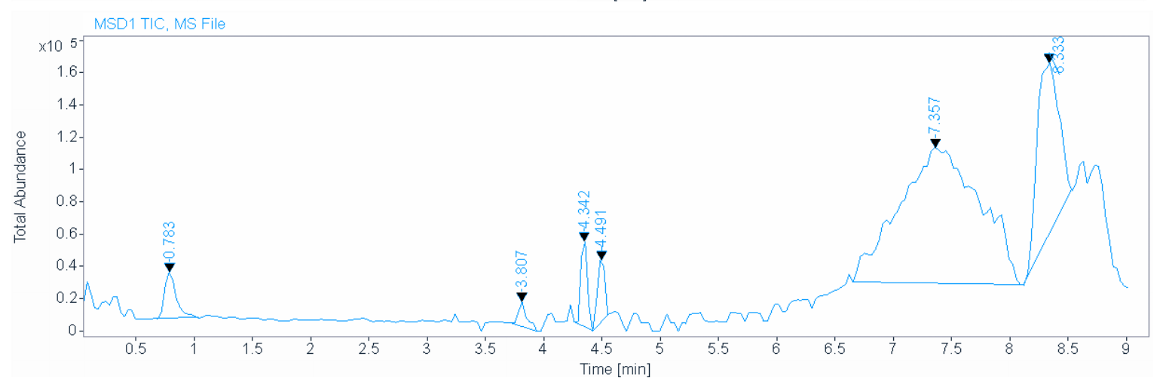
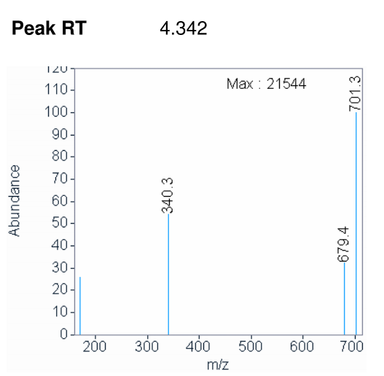
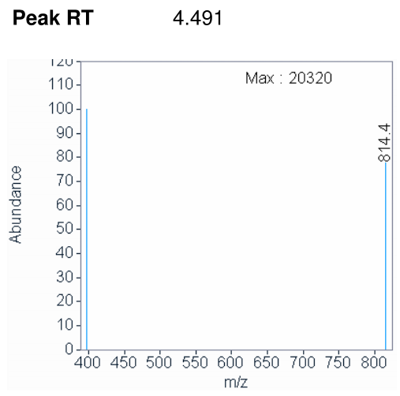
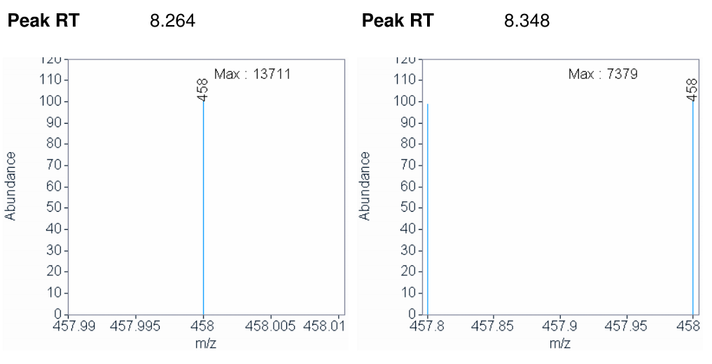
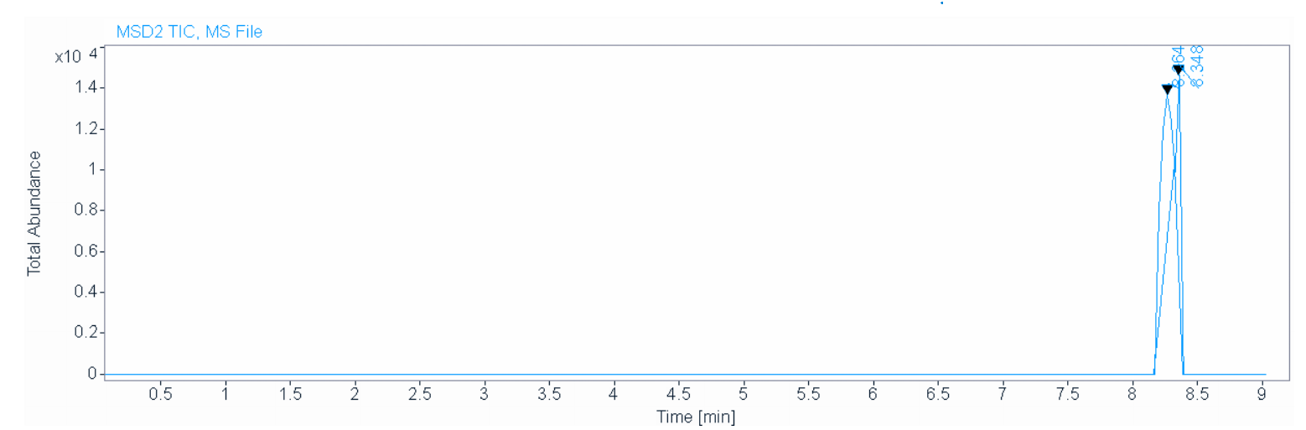
CNP27: SARS-CoV-2-NSP14 target-384 compounds (Nick Heaton library) HTS
Product
MW: 340.38 g/mol
Product
Tetrahedron Letters, Volume 55, Issue 41, 2014,Pages 5591-5594,
https://doi.org/10.1016/j.tetlet.2014.08.060.
Notes:
Use cesium carbonate (2 eq) and 0.95 eq of alkyle aldehyde
Check Bordwell PKa table
I should add 2 eq base and one eq alkyle
PKa NH amide is 17/ PKa NH purrole is 15-> amide is more basic than pyrrole
The rule says: the latest deprotonated is the first alkylated that means the more basic group is the 1st alkylated
The archetypal Beckmann rearrangement^{[4]} is the conversion of cyclohexanone to caprolactam via the oxime
Cyclopentapyrrole and Cyclohexapyrrole analogues.
Pyrrole piperidinone

Slide 8
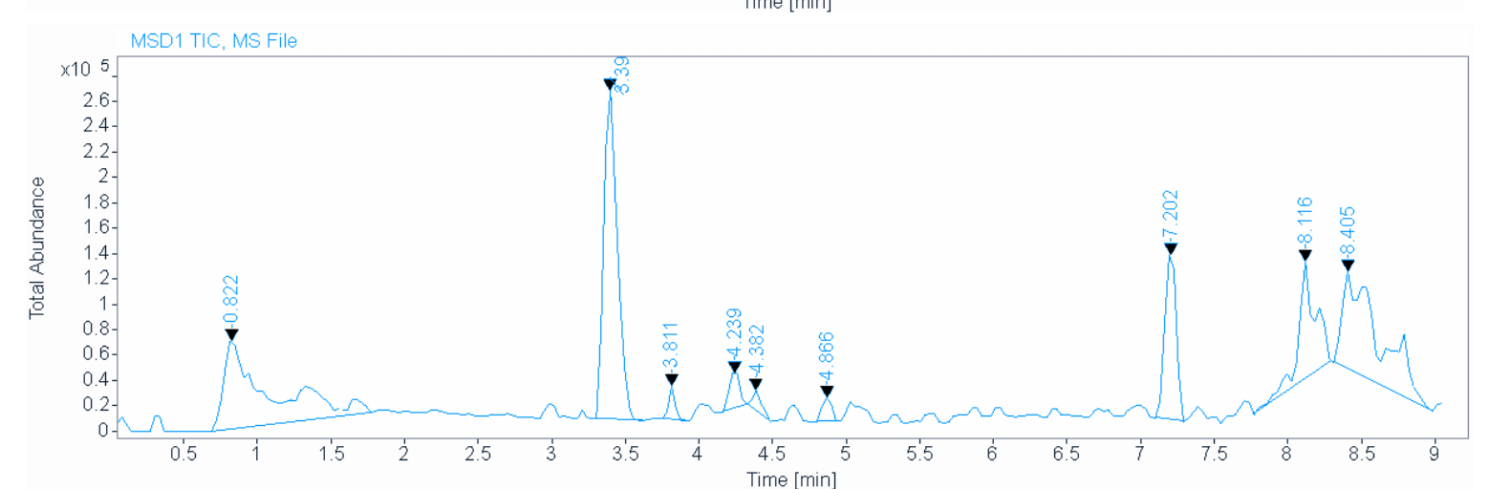

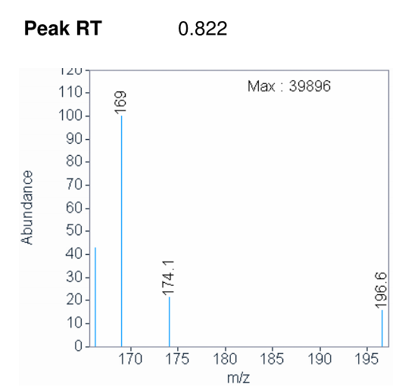
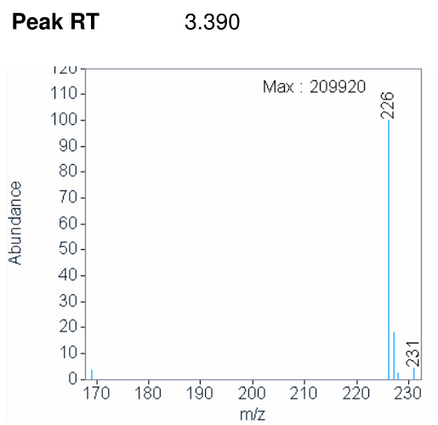
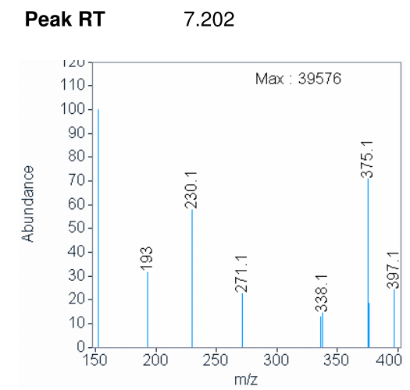
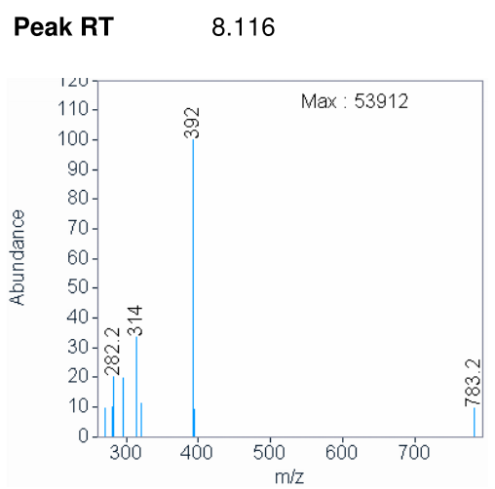
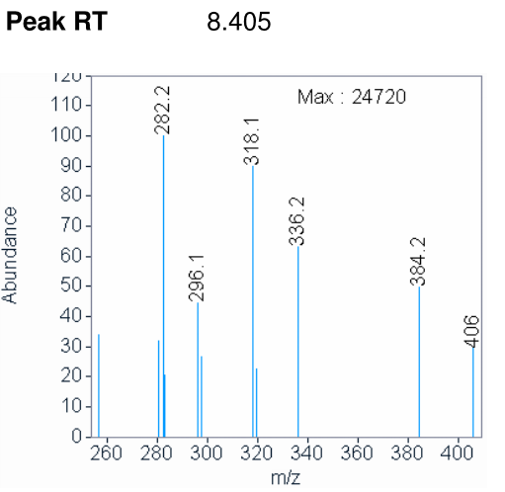
CNP27: SARS-CoV-2-NSP14 target-384 compounds (Nick Heaton library) HTS
MW: 222.24 g/mol
MW: 312.37 g/mol
Tetrahedron Letters, Volume 55, Issue 41, 2014,Pages 5591-5594,
https://doi.org/10.1016/j.tetlet.2014.08.060.
Notes:
Use cesium carbonate (2 eq) and 0.95 eq of alkyle aldehyde
Check Bordwell PKa table
I should add 2 eq base and one eq alkyle
PKa NH amide is 17/ PKa NH purrole is 15-> amide is more basic than pyrrole
The rule says: the latest deprotonated is the first alkylated that means the more basic group is the 1st alkylated
The archetypal Beckmann rearrangement^{[4]} is the conversion of cyclohexanone to caprolactam via the oxime
Cyclopentapyrrole and Cyclohexapyrrole analogues.
Pyrrole piperidinone

Slide 9
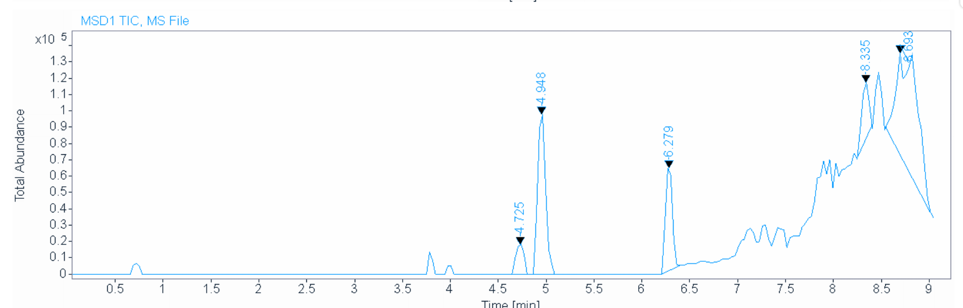
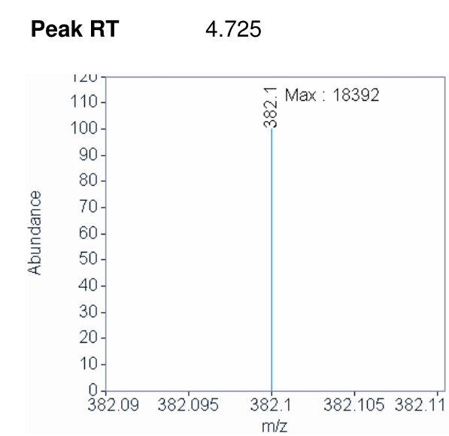
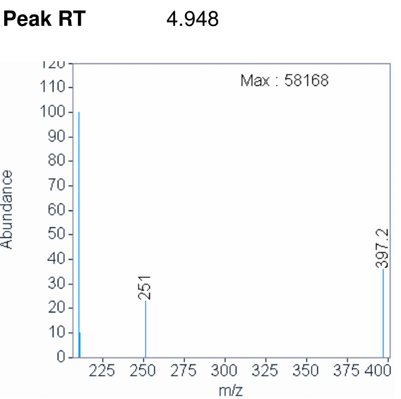
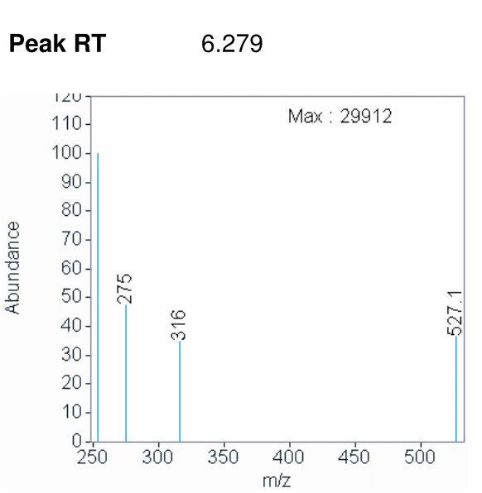
CNP27: SARS-CoV-2-NSP14 target-384 compounds (Nick Heaton library) HTS
I got the product after column although it did not appear on LCMS
MW: 222.24
MW: 340.38
The Journal of Organic Chemistry 2008 73 (7), 2792-2802
DOI: 10.1021/jo8001003
Notes:
Use cesium carbonate (2 eq) and 0.95 eq of alkyle aldehyde
Check Bordwell PKa table
I should add 2 eq base and one eq alkyle
PKa NH amide is 17/ PKa NH purrole is 15-> amide is more basic than pyrrole
The rule says: the latest deprotonated is the first alkylated that means the more basic group is the 1st alkylated
The archetypal Beckmann rearrangement^{[4]} is the conversion of cyclohexanone to caprolactam via the oxime
Cyclopentapyrrole and Cyclohexapyrrole analogues.
Pyrrole piperidinone

Slide 10

CNP27: SARS-CoV-2-NSP14 target-384 compounds (Nick Heaton library) HTS
8 Analogues to register and ship next week
Notes:
Use cesium carbonate (2 eq) and 0.95 eq of alkyle aldehyde
Check Bordwell PKa table
I should add 2 eq base and one eq alkyle
PKa NH amide is 17/ PKa NH purrole is 15-> amide is more basic than pyrrole
The rule says: the latest deprotonated is the first alkylated that means the more basic group is the 1st alkylated
The archetypal Beckmann rearrangement^{[4]} is the conversion of cyclohexanone to caprolactam via the oxime
Cyclopentapyrrole and Cyclohexapyrrole analogues.
Pyrrole piperidinone

Slide 11
Notes from Mat’s meeting@
1-Rearrangement reaction: 7 membered ring- do this reaction which is easier than 6 membered ring and do the alkylation, it might be more active
2- do the 6 membered ring lactam in a big scale
And prove that the R is on the lactam not on the pyrrole
which will be crystallise, you can also do this reaction starting from ,
you can alkylate it with the R you want then you make the 2nd step

